Slide 1
Guidelines for using the FIBA OBR2026 NF Package
FIBA Referee Operations has composed a package for National Federations to better communicate the changes to the Official Basketball Rules which take effect on 1 October 2026
Material provided
The FIBA Official Basketball Rules 2026 (pdf)
The Summary of the Rules Changes 2026 document (pdf)
These Presentation slides * (pdf)
Videos 1-15 ** (mp4)
These presentation slides do not contain all the information and all the minor or editorial changes made to the rules. They are intended to be used in combination with the The Summary of the Rules Changes 2026 document, in which the new rule texts for the major changes can be found.
How to use the material
It can be translated (FIBA logo cannot be used)
You can copy and paste the content into your own template (FIBA logo cannot be used)
A reference “FIBA OBR2026 NF Package” should be added
The videos cannot be edited.
Please Note!
FIBA is not responsible for the content of the translation(s).

Slide 2
Official Basketball Rules
Changes 2026
FOR NATIONAL FEDERATIONS

Slide 3
Summary of Changes – OBR 2026
MAJOR
MINOR
Art. 15 Player in the act of shooting
Art. 36 Technical foul
Art. 37 Disruptive foul
Art. 38 Flagrant foul
Appendix F : Instant Replay System & HCC
Art. 1 Definitions - terminology
Art. 2 Court - Lines
Art. 4 Teams - Uniforms
Art. 24 Dribbling
Appendix A : Officials Signals
Appendix B : Scoresheet
Appendix D : Classifications of teams

Slide 4
Minor Changes

Slide 5
Art. 1 Definitions - terminology
Whenever the role of “commissioner” is referenced, it also applies to the role of “technical delegate”.
The clarification ensures terminological consistency across competitions where different governance structures are applied.

Slide 6
Art. 2 Court – Lines (1)
Increased flexibility in line colours enables integration of event branding and commercial design elements, while maintaining essential visibility and fairness standards.
All lines shall be of a solid colour, 5 cm in width, clearly visible and in high contrast with the colour(s) of the playing court and the further boundary lane.
The colours of the boundary lines and the court markings, or the court markings themselves, may differ, however, the following principle must apply:

Slide 7
Art. 2 Court – Lines (2)
      All boundary lines, including sidelines, end lines, throw-in lines and team bench area lines, must be of the same colour.
      The colour of each pair of court markings must match on both half-courts. These include:
  Restricted area, including free-throw rebound places
  Free throw semi-circles
  Free throw lines
  3-point lines
  No-charge semi-circles
      The centre line and the centre circle may be of a different colour than the boundary lines and other court markings. The centre line and the centre circle, between each other, may be of the same colour or of different colours

Slide 8
Art. 2 Court – Lines (3)
Court markings – boundary lines
Visual sample(s) of court markings to be included
1
      All boundary lines, including sidelines, end lines, throw-in lines and team bench area lines, must be of the same colour
SCORER’S TABLE
1
1
1

Slide 9
Art. 2 Court – Lines (3)
Court markings – pairs of court markings
Visual sample(s) of court markings to be included
      The colour of each pair of court markings must match on both half-courts. These include:
  Restricted area
  (including free-throw rebound places)
  Free throw semi-circles
  Free throw lines
  3-point lines
  No-charge semi-circles
SCORER’S TABLE
6
6
3
4
7
3
4
4
3
7
5
5
5
6
7

Slide 10
Art. 2 Court – Lines (4)
Court markings – the centre line and the centre circle
Visual sample(s) of court markings to be included
2
      The centre line and the centre circle may be of a different colour than the boundary lines and other court markings. The centre line and the centre circle, between each other, may be of the same colour or of different colours
SCORER’S TABLE
2
2

Slide 11
Art. 4 Teams - Uniforms
Socks
The socks of all team members shall be of the same dominant colour. The socks do not have to be visible.
The removal of the requirement for socks to be visible reflects the practical realities of modern equipment, reducing unnecessary administrative interruptions and enforcement issues.

Slide 12
Art. 24 Dribbling
The revision and update of Article 24.2 clarifies that for a player to lose control of a live ball, any one of the three conditions listed in the article must apply.
A player shall not dribble for a second time after the player’s first dribble has ended unless the player has lost control of a live ball on the court because of one of the following:
      A shot for a goal.
      The ball is touched by an opponent.
      On a pass or fumble the ball touches or is touched by another player

Slide 13
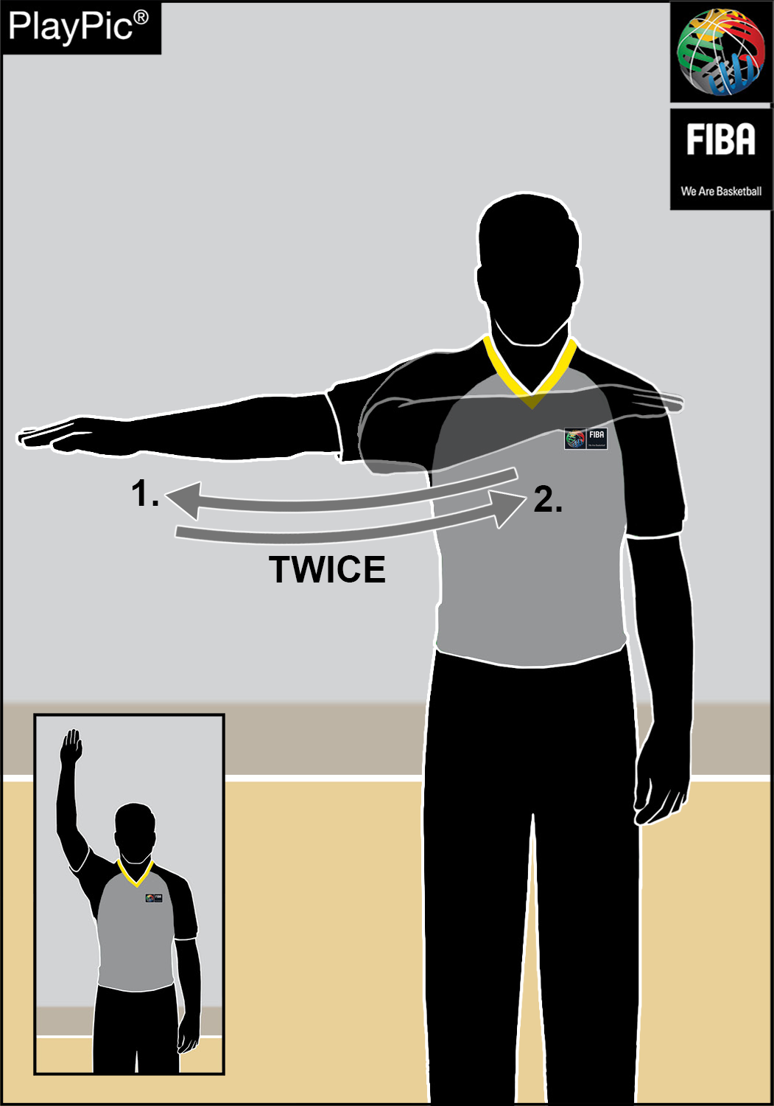
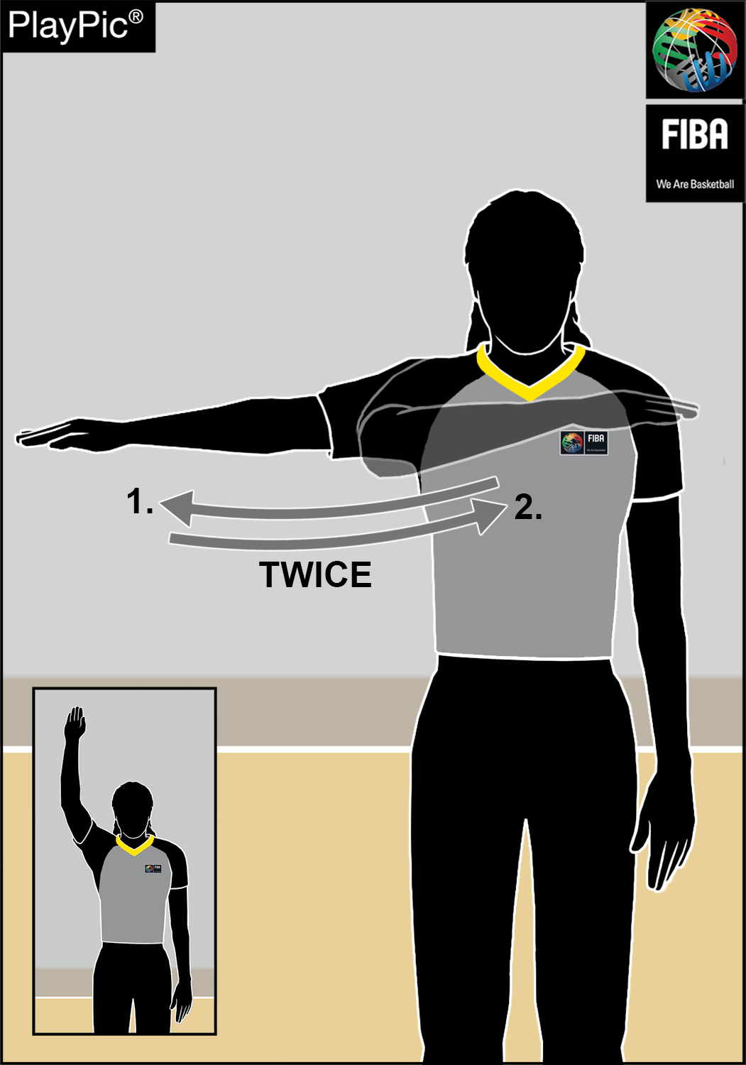
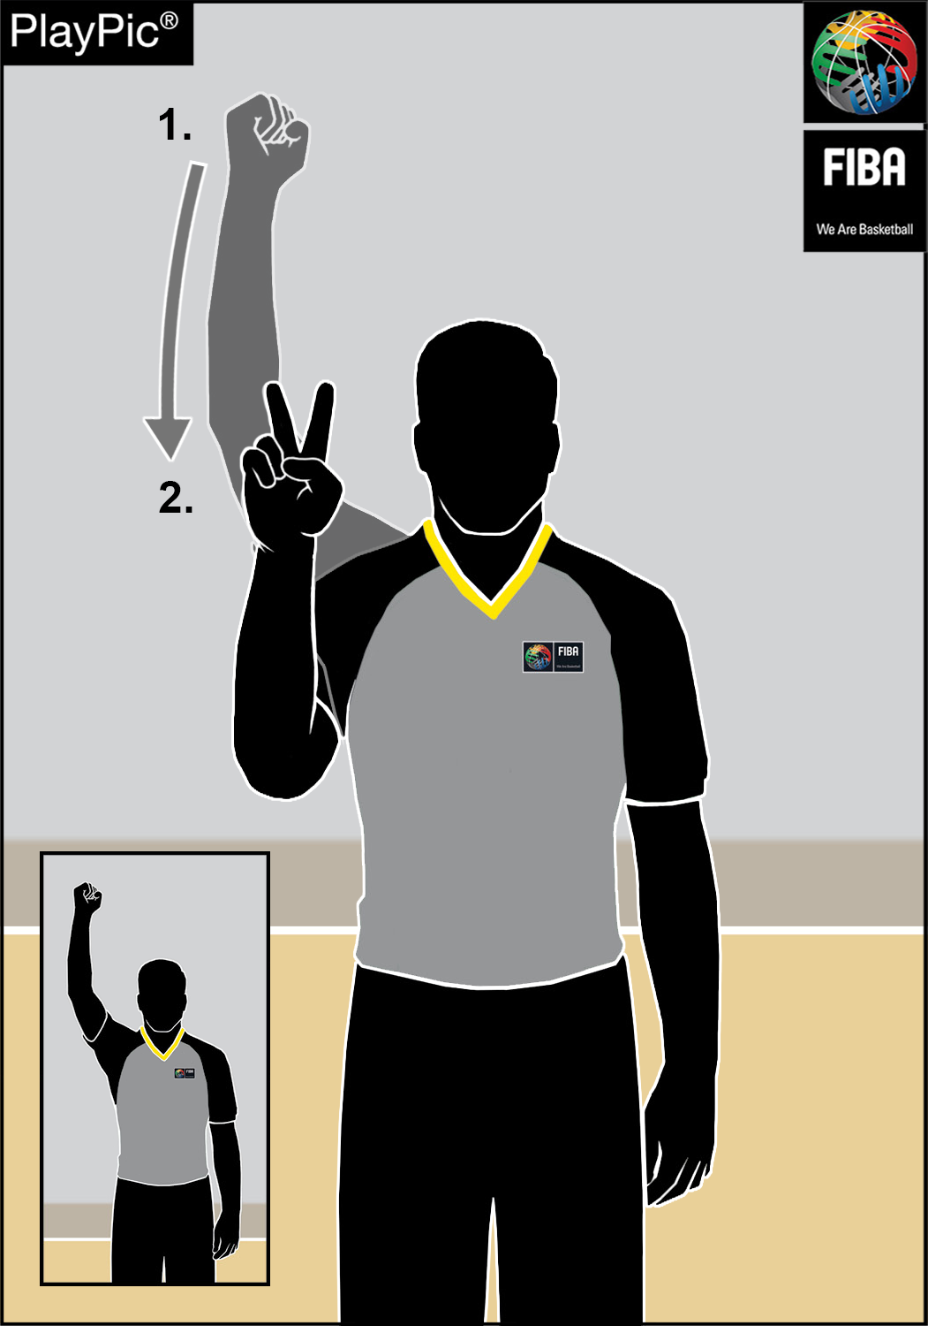
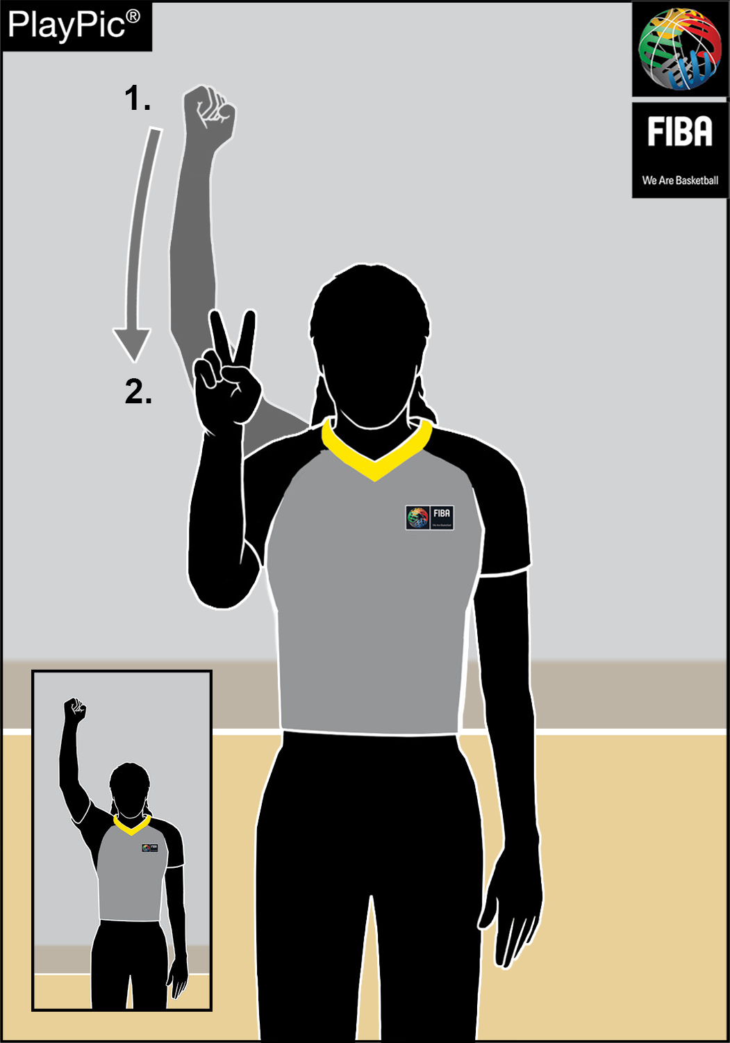
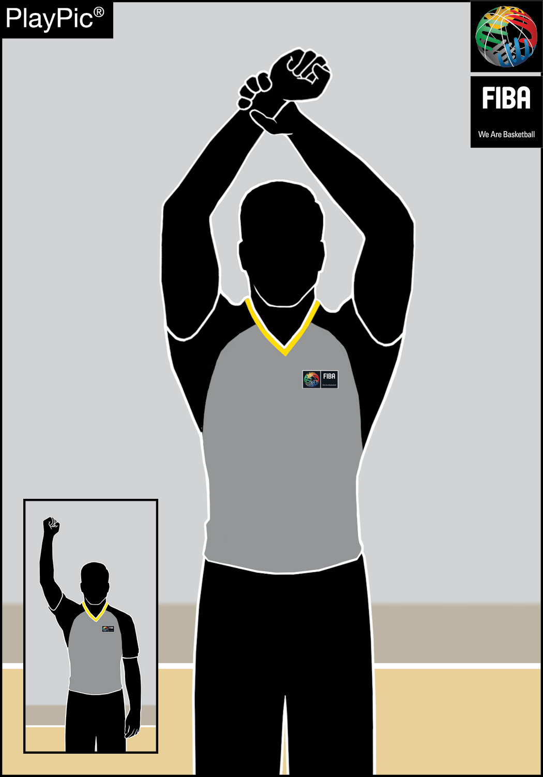
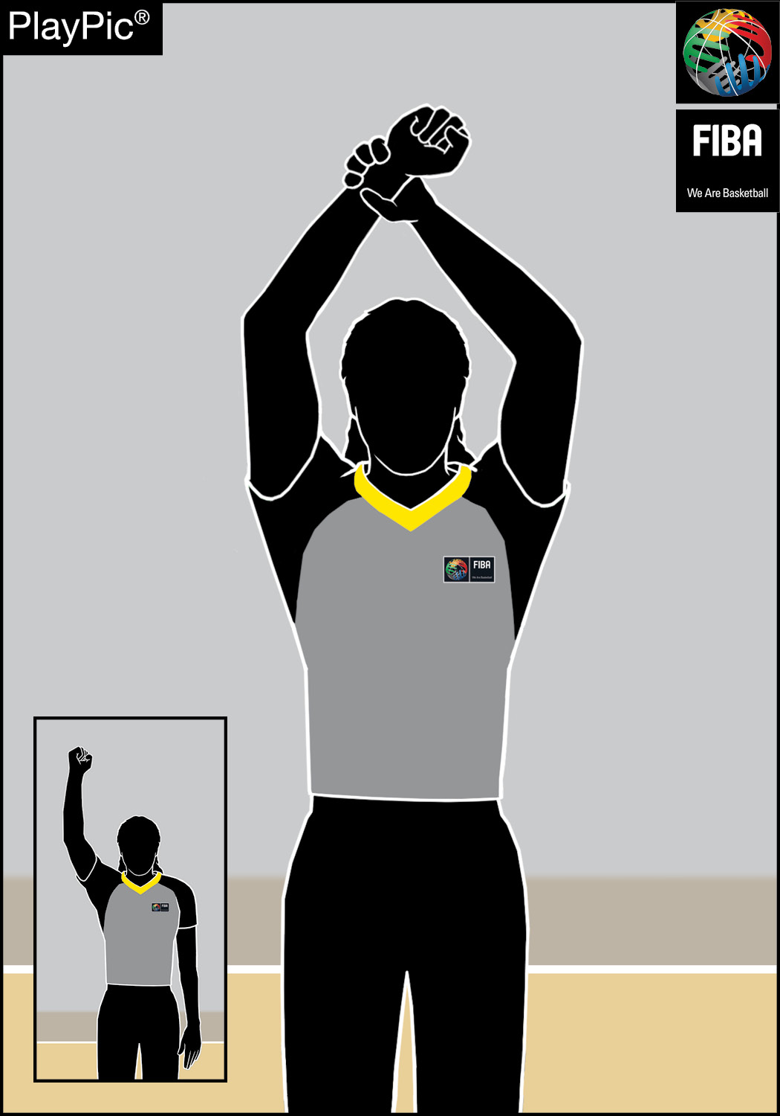
Appendix A: Officials Signals
New Referee Signals
Delay of game Disruptive foul Flagrant foul

Slide 14





The new scoresheet markings
Appendix B: Scoresheet
A new principle has been introduced that any foul counting towards game disqualification is to be marked with a circle to ensure clarity.
New abbreviations have also been introduced to cover the new foul types.
1. | Disruptive Foul/Player | DI
2. | Flagrant Foul/Player
3. | Technical Foul Category 1/Player
4. | Technical Foul Category 2/Player | T
5. | Technical Foul Category 1/Head Coach
6. | Technical Foul Category 1/Bench
7. | Technical Foul Category 1/Disqualifying Foul against an Accompanying Delegation Member

Slide 15
Appendix D: Classifications of teams
D.5 Classifications of teams in a Tournament of Phases
The new article D.5.2, clarifies the classification rules for teams eliminated in the quarterfinals, qualification to quarterfinals, round of 16, etc.

Slide 16
Major Changes

Slide 17
Art. 15 Player in the act of shooting (AOS)
The changes are intended to:
      Differentiate the AOS for different types of shots: drives to basket, jump shots and other moving shots;
      Indicate locations and directions, e.g. drives to basket between 3-point line and the basket;
      Define the movement of the player’s body parts for an action to be considered an AOS;
      Disregard any «shot» from the backcourt, when a player attempts to draw a foul, unless the shot is taken at the end of the quarter/overtime or at the end of the shot clock at any time in the game.

Slide 18
Art. 15 Player in the act of shooting (AOS)
Conseptual Change
SHOT
CONTINOUS MOVEMENT
JUMP SHOT
MOVING SHOT
DRIVE TO BASKET
Upward motion
Gather the ball

Slide 19
The act of shooting…
On jump shots or other moving shots:
      Starts when the player begins to move the shoulders and the ball upwards towards the opponents’ basket.
      Ends when the ball has left the player’s hand(s), or if an entirely new act of shooting is made and, in case of an airborne shooter, both feet have returned to the floor.

Slide 20

Video Examples
Videos
252
253

Slide 21
The act of shooting…
In a continuous movement on drives to the basket:
A continuous movement in the act of shooting on drives to the basket is an action of the player in the team’s frontcourt, typically starting between the offensive 3-point line and the basket, in which the player gathers the ball upon completion of a dribble or catches the ball while progressing, and then continues the shooting motion towards the basket, usually upwards.

Slide 22
The act of shooting…
In a continuous movement on drives to the basket:
      Starts when the player has gathered the ball and it comes to rest in the player’s hand(s), upon completion of a dribble or a catch in the air and the player continues the shooting motion preceding the release of the ball for a goal.
      Ends when the ball has left the player’s hand(s), or if an entirely new act of shooting is made and, in case of an airborne shooter, both feet have returned to the floor.

Slide 23
Video Examples
Videos
250
251

Slide 24
The act of shooting…
For a player to be in the act of shooting, the player must be in the frontcourt.
An exception is made that a player may be anywhere on the court during the last action before:
      the expiration of a game clock for the end of the quarter or overtime; or
      the expiration of a shot clock at any time of the game.
In such cases, the act of shooting starts when the player has gathered the ball and it comes to rest in the player’s hand(s).

Slide 25
Video Examples
Videos
256

Slide 26
The act of shooting…
On jump shots or other moving shots
When a player is in the act of shooting on jump shots or other moving shots and after being fouled:
      passes the ball off; or
      if the ball is moved upwards in a direction away from the basket, or
      if the player is not facing the basket when the ball is moved in an upwards motion,
that player is no longer considered to have been in the act of shooting.

Slide 27
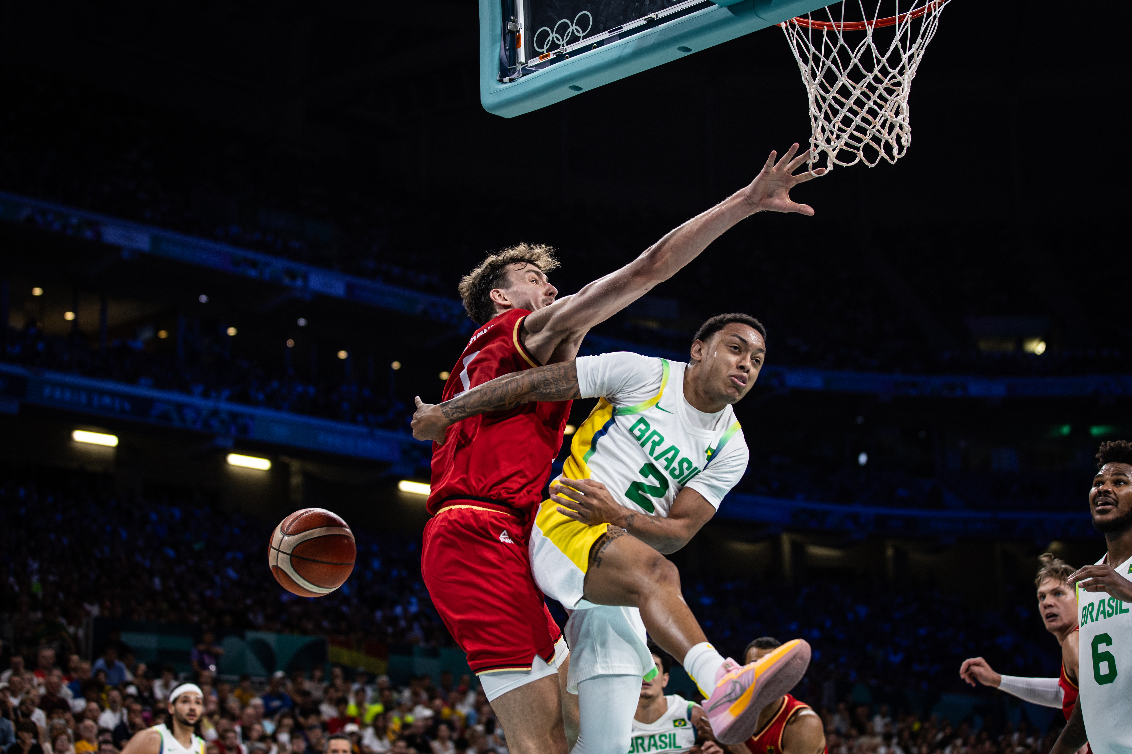
The act of shooting…
On drives to the basket
No changes.
When a player is in the act of shooting on drives to the basket and after being fouled passes the ball off that player is no longer considered to have been in the act of shooting.

Slide 28
Video Examples
Videos
254
255

Slide 29
Art. 36 Technical foul
Two categories of fouls
Based on their nature and severity level, the technical fouls (TFs) have been divided into two categories, with more severe ones (category 1) counting towards game disqualification (GD) and the less severe ones (category 2) not counting towards GD.
Technical Foul
Category 1
Category 2

Slide 30
Art. 36 Technical foul
Two categories of fouls
Category 1
Category 2
Delaying the game
Hanging on the ring
Goaltending during last FT
Disrespectful behaviour
Excessive swinging of elbows
Fake being fouled
Part of
Game Disqualification
NOT
Part of Game Disqualification

Slide 31
Art. 36 Technical foul
Category 1 technical fouls
      by a player may be non-contact or contact fouls of a behavioural nature including, but not limited to:
      Disrespectfully dealing and/or communicating with the referees, the commissioner, if present, the table officials, the opponents, or persons permitted to sit on the team benches.
      Using language or gestures likely to offend or incite the spectators.
      Baiting, taunting, or provoking an opponent, including a contact with the hands, arms, body, or the ball, which does not rise to the level of a flagrant or a disqualifying foul.
      Obstructing the vision of an opponent by waving/placing the hand(s) near the opponent’s eyes.
      Excessive swinging of elbows, without contact.
      Fake being fouled.
Category 1

Slide 32
Art. 36 Technical foul
Technical fouls by a head coach and persons permitted on the team bench
Category 1
      A technical foul charged against a head coach or any person permitted to sit on the team bench is always category 1 technical foul.

Slide 33
Art. 36 Technical foul
Category 2 technical fouls
      by a player may be non-contact fouls of a behavioural or administrative nature including, but not limited to:
      Delaying the game by deliberately touching the ball after it passes through the basket or by preventing a throw-in or a free throw from being taken promptly or coming on the court late to start the game or the second half.
      Hanging on the ring in such a way that the weight of the player is supported by the ring.
      Goaltending during the last free throw by a defensive player.
Category 2

Slide 34
Video Examples
Videos
280
281

Slide 35
Art. 37 & 38 Disruptive and Flagrant fouls
Category 2
The former unsportsmanlike foul has been replaced with two separate foul types, with more severe ones (flagrant fouls) counting towards game disqualification (GD) and the less severe ones (disruptive fouls) not counting towards GD.
Unsportsmanlike Foul
Disruptive
Foul
Flagrant
Foul

Slide 36
Art. 37 Disruptive fouls
OBR 2024
OBR 2026
UF - not legitimate basketball play to stop the game/flow (Criteria 1)
DI - not legitimate attempt to directly play the ball in transition (Criteria 1)
UF - unnecessary contact in transition (Criteria 3)
DI - no legitimate basketball play to stop the game (Criteria 2)
UF - clear path to the basket (Criteria 4)
DI - clear path to the basket
(Criteria 3)
Part of Game Disqualification
NOT part of Game Disqualification

Slide 37
Art. 37 Disruptive foul
Definition
A disruptive foul is a player’s illegal contact with an opponent which does not rise to the level of a flagrant foul, and which disrupts the flow of the game and places the opponent at a disadvantage.

Slide 38
Art. 37 Disruptive foul
Criteria
      An unnecessary contact caused by the defensive player, not legitimately attempting to directly play the ball, in order to stop the progress of the offensive team in transition. This applies until the offensive player starts the act of shooting.
      An unnecessary contact caused by the defensive player anywhere on the court, not legitimately attempting to directly play the ball, in order to stop the game clock and/or shot clock, at the end of a quarter or overtime.
      An illegal contact caused by a player from behind or laterally on an opponent, who is progressing towards the opponent’s basket and with no opponents between the progressing player and the basket, and:
        The progressing player is in control of the ball, or
        The progressing player is attempting to gain control of the ball, or
        The ball has been released on a pass to the progressing player.
      This applies until the offensive player starts an act of shooting.

Slide 39
Art. 37 Disruptive foul
Penalty
      A disruptive foul shall be charged against the offender and shall count as one of the team fouls.
      1, 2 or 3 free throw(s) shall be awarded to the player who was fouled, followed by a throw-in from the throw-in line in the team’s frontcourt, opposite the scorer’s table.

Slide 40
Video Examples
Videos
270
271
272

Slide 41
Art. 38 Flagrant foul
Definition
      A flagrant foul is a player’s illegal contact with an opponent, which violates the spirit of sportsmanship and fair play, and by its nature and/or the severity level, exceeds the limits of a personal or disruptive foul.

Slide 42
Art. 38 Flagrant foul
OBR 2024
OBR 2026
UF - not legitimate basketball play, dangerous & reckless action (Criteria 1)
FL - not legitimate basketball play against an opponent (Criteria 1)
FL - reckless, violent or dangerous act (Criteria 2)
UF - excessive, hard contact playing the ball or opponent (Criteria 2)
FL - excessive, hard contact playing the ball or opponent (Criteria 3)
Part of Game Disqualification
Part of Game Disqualification

Slide 43
Art. 38 Flagrant foul
Criteria
      The criteria for flagrant fouls are the following:
      Not a legitimate basketball play against an opponent, with or without a ball.
      Reckless, violent or dangerous act, which causes or may cause injury to an opponent.
      Excessive, hard contact in an effort to play the ball or an opponent.

Slide 44
Art. 38 Flagrant foul
Penalty
      A flagrant foul shall be charged against the offender and shall count as one of the team fouls.
      1, 2 or 3 free throw(s) shall be awarded to the player who was fouled, followed by:
      A throw-in from the throw-in line in the team’s frontcourt, opposite the scorer’s table.
      A jump ball in the centre circle at the start of the first quarter.

Slide 45
Combination of Fouls
Flagrant Foul
Flagrant Foul
Player Game Disqualification
Technical Foul
Category 1
Technical Foul
Category 1
GD
Flagrant Foul
Technical Foul / Category 1

Slide 46
Video Examples
Videos
261
262
263

Slide 47
Appendix F : Instant Replay System & HCC
Replay Reviews
Two new possible review situations have been added.
In the last 2 minutes (L2M):
      whether the ball was still in the hands of the thrower-in when a throw-in foul was committed.
At any time in the game:
      whether a goaltending or basket interference violation occurred after a foul was committed and whether any such violation was called correctly.

Slide 48
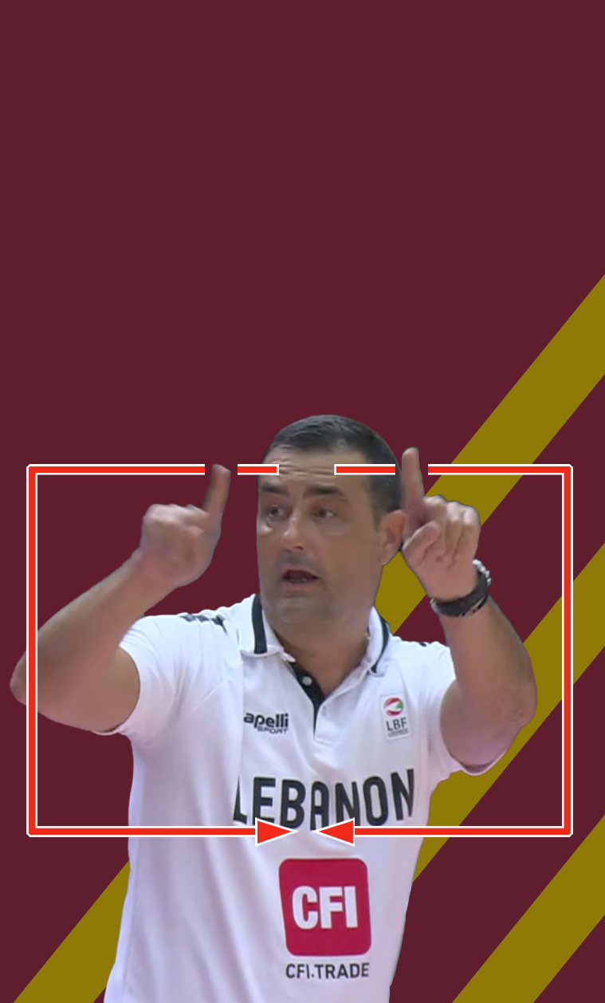
Appendix F : Instant Replay System & HCC
Head Coach’s Challenge (HCC)
The two new additions also apply for the head coach’s challenge (HCC) rule.
The HCC may be requested at any time in the game.
As per Art F.4.2, the time restrictions within Appendix F.3.1 and F.3.2 do not apply.

Slide 49
END OF SLIDES

